Slide 1
PROBABILITY & STATISTICS
KODE DOSEN : NKC / MATA KULIAH : PROBABILITAS & STATISTIKA (MUH1F3)

Slide 2
The Emergence Of Probability
Probability owes its existence to gambling
The Two Major results of the book are :
The Probability that one of two exclusive events occurs equals the sum of their probabilities
The probability that two in dependent events occurs simultaneously equals the product of their probabilities
Gerolamo Cardano wrote “The Book on Dice Games” in which he develops a theory of odds and probabilities
Probability
KODE DOSEN : NKC / MATA KULIAH : PROBABILITAS & STATISTIKA (MUH1F3)

Slide 3
The Emergence Of Statistics
Science of States
The original meaning
Political Arithmetic
Statistics
Historically
From the Latin word “Status” meaning “State”
KODE DOSEN : NKC / MATA KULIAH : PROBABILITAS & STATISTIKA (MUH1F3)

Slide 4
Did You Know ?
PROBABILITY ?
STATISTICS ?
KODE DOSEN : NKC / MATA KULIAH : PROBABILITAS & STATISTIKA (MUH1F3)

Slide 5
Probability is Daunting & Confusing
Hard Subject
Difficult Subject
Complex Idea
PROBABILITY
Difficult to apprehend
IS AN EXQUISITELY BEAUTIFUL FIELD OF MATHEMATICS
KODE DOSEN : NKC / MATA KULIAH : PROBABILITAS & STATISTIKA (MUH1F3)

Slide 6
What is Probability ????
In general, it is a number that describes the change that something will happen
Probability is a number between 0 and 1 which expresses the chance that a specific event occurs under stated conditions
Probability is complex idea.
An understanding of the complexity of probability should encourage humility when teaching the subject
Probability
The word probability has no precise definition
The term probability refers to the study of randomness and uncertainty.
Everyone encounters uncertainty Unpredictable result are said to be “random”
or to “ happen by chance”
Is an integral part of all statistics; it is essential to the theory of statistical inference
These questions have been debated for several hundred years does not dictate a unique definition of “probability”
KODE DOSEN : NKC / MATA KULIAH : PROBABILITAS & STATISTIKA (MUH1F3)

Slide 7
The Stuff of Probability #1
Experiment is a process that result in an outcome
Called Random experiment if its outcome cannot be predicted in advance with certainty
Sample
Space
Event
Sample Space (Ω) : The Set of all Possible outcomes of an random experiment.
Experiment
Random
Experiment
Event : A subset of a sample space
KODE DOSEN : NKC / MATA KULIAH : PROBABILITAS & STATISTIKA (MUH1F3)

Slide 8
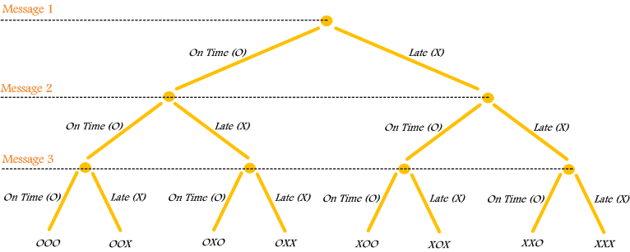
The Stuff of Probability #2
Each message in a digital communication system is classified by the time it is received in the system. Each message can be received either “on time” or “late” . If three messages are received, use a tree diagram to represent the sample space of possible outcomes. Each message can be received either on time or late.
$$Ω= \left\{ooo , oox , oxo, oxx,xoo, xox, xxo, xxx\right\}$$
$A= \left\{ooo, oox, oxo, xoo\right\}$ → Event Minimum 2 Message Received On Time
KODE DOSEN : NKC / MATA KULIAH : PROBABILITAS & STATISTIKA (MUH1F3)

Slide 9
The Stuff of Probability #3
An automobile manufacturer provides vehicles equipped with selected options.
With or without an automatic transmission
With or without a sunroof
With one of three choices of a stereo system
With one of four exterior colors (Black, Red, Yellow, Green)
If the sample space consists of the set of all possible vehicle types, what is the number of outcomes in the sample space? 48
KODE DOSEN : NKC / MATA KULIAH : PROBABILITAS & STATISTIKA (MUH1F3)

Slide 10
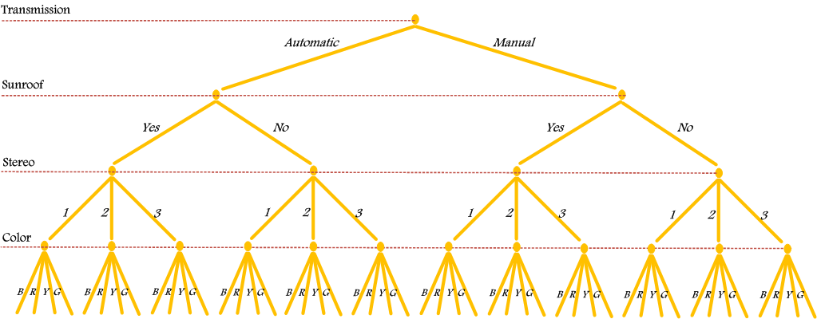
The Stuff of Probability #4
KODE DOSEN : NKC / MATA KULIAH : PROBABILITAS & STATISTIKA (MUH1F3)

Slide 11
Interpretation Of Probability
Axiomatic
The Approaches of Probability
Subjective
Objective
Classical
(Equally Likely)
Empirical
(Relative Frequency)
KODE DOSEN : NKC / MATA KULIAH : PROBABILITAS & STATISTIKA (MUH1F3)

Slide 12
Axiomatic Probability #1
If sample space Ω is countable, the set of all subsets of Ω (sometimes called a class), which is known as the power set of Ω, is then the set of all events.
A class of sets, $P \left(Ω\right)=class=$𝔅 , that contains φ and Ω is closed under complements and countable unions, is sometimes called a σ-field or σ-algebra of subsets of Ω.
The members of such a class are called event space.
To each , P(A) is a real number called the probability of A.
$$A ε 𝕭$$
We symbolize this by writing and speak of P mapping 𝔅 into ℝ
$$P : 𝕭→ℝ$$
KODE DOSEN : NKC / MATA KULIAH : PROBABILITAS & STATISTIKA (MUH1F3)

Slide 13
Axiomatic Probability #2
Let Ω be a given sample space and 𝔅 the corresponding event space. A probability function P is a real-valued function with domain 𝔅 such that :
AXIOM 1.
AXIOM 2.
AXIOM 3. If are MEE (members of 𝔅 ), then
$$P \left(\bigcup_{j=1}^{∞}{A_{j}}\right)=\sum_{j=1}^{∞}{P(A_{j})}$$
-- The triple ( Ω, 𝔅, P) is called a Probability Space --
$P\left(A\right)≥0$ , for every $A ε 𝕭$
$$P\left(Ω\right)=1$$
$A_{1},A_{2}, A_{3}$,...
If $A_{1},A_{2}, A_{3}$,... are MEE,
$$A_{1}∩ A_{2}∩A_{3}= ∅$$
$$P\left[A_{1}∪ A_{2}∪A_{3}\right]=P\left[A_{1}\right]+P\left[A_{2}\right]+P\left[A_{3}\right]$$
KODE DOSEN : NKC / MATA KULIAH : PROBABILITAS & STATISTIKA (MUH1F3)

Slide 14
Objective Probability
If it is known that event A can occur in m ways and a total of n equally likely ways is possible, the true probability P(A) is :
$$P\left(A\right)= \frac{Number of favorable Outcomes}{Total number of possible Outcomes}= \frac{m}{n}$$
$$P\left(Event\right)= \frac{Number of favorable Outcomes}{Total number of possible Outcomes}$$
CLASSICAL (Equally Likely ) a priori
Objective Probability
If an equally likely event A occurs m times in a total of n trials, the observed probability P*(A) is :
$$P^{∗}\left(A\right)=\frac{Times A Occurred}{Total Trials}=\frac{m}{n}$$
$$\lim_{n→∞}{P^{∗}(}A)=P(A)$$
P*(A) Approaches the true probability of event A
$$P\left(Event\right)= \frac{Number of times event occured}{Total number of observation}$$
EMPIRICAL (Relative Frequency)a posteriori
KODE DOSEN : NKC / MATA KULIAH : PROBABILITAS & STATISTIKA (MUH1F3)

Slide 15
Subjective Probability
Subjective probabilities are based on the beliefs of the person making the probability assessment. In fact, subjective probability can be defined as the probability assigned to an event by an individual, based on whatever evidence is available.
This evidence may be in the form of relative frequency of past occurrences, or it may be just an educated guess.
This is the best educated estimate or guess of the probability of event A.
Actually, many business decision are based on subjectively evaluated probabilities made in the absence of historical data
The likelihood (probability) of a particular event happening that is assigned by an individual based on whatever information is available
KODE DOSEN : NKC / MATA KULIAH : PROBABILITAS & STATISTIKA (MUH1F3)

Slide 16
What is Statistics ????
Po
Population → Parameter
Sample → Statistic
Cost
Time
Resources
A population is the set of all measurements of interest to the investigator
A sample is a subset of measurements selected from the population of interest
KODE DOSEN : NKC / MATA KULIAH : PROBABILITAS & STATISTIKA (MUH1F3)

Slide 17
What is Statistics ????
STATISTICIAN ?
STATISTICS ?
STATISTIC ?
The statistician studies various inferential procedures, looking for the best decision making process for a given situation.
A statistic is a function of the random variable observed in a sample the statistic itself is a random variable.
Statistics is the science of gaining information from numerical data.
KODE DOSEN : NKC / MATA KULIAH : PROBABILITAS & STATISTIKA (MUH1F3)

Slide 18
Probability And Statistics
Probability and Statistics are related in a most curious way. In essence, probability is the vehicle which enables the statistician to use information in a sample to make inferences or describe the population from which the sample was obtained
Probability reasons from the population to the sample, while statistics acts in reverse, moving from the sample to the population.
KODE DOSEN : NKC / MATA KULIAH : PROBABILITAS & STATISTIKA (MUH1F3)

Slide 19
DESCRIPTIVE STATISTICS
KODE DOSEN : NKC / MATA KULIAH : PROBABILITAS & STATISTIKA (MUH1F3)

Slide 20
What is Statistics ????
Po
Population → Parameter
Sample → Statistic
Cost
Time
Resources
A population is the set of all measurements of interest to the investigator
A sample is a subset of measurements selected from the population of interest
KODE DOSEN : NKC / MATA KULIAH : PROBABILITAS & STATISTIKA (MUH1F3)

Slide 21
statistics
Statistics, the art of drawing conclusions from imperfect data. In a nutshell, statistics is a subject in which we learn facts about the real world through observations.
Statistics is the science that deals with the organizing, summarizing, and interpreting of numerical information, called data.
Statistics is the art of making inferences and drawing conclusions form imperfect data. Data values are often imperfect, in that they convey useful information but do not tell the whole story. Statistical methods can be used in all parts of a study from beginning to end.
KODE DOSEN : NKC / MATA KULIAH : PROBABILITAS & STATISTIKA (MUH1F3)

Slide 22
DATA ???
Statistics is the science of gaining information from DATA
Data are of course numbers, but they are more than that
DATA
Data are numbers with a context
Data can be thought of as the numerical information needed to help us make a more informed decision in a particular situation
KODE DOSEN : NKC / MATA KULIAH : PROBABILITAS & STATISTIKA (MUH1F3)

Slide 23
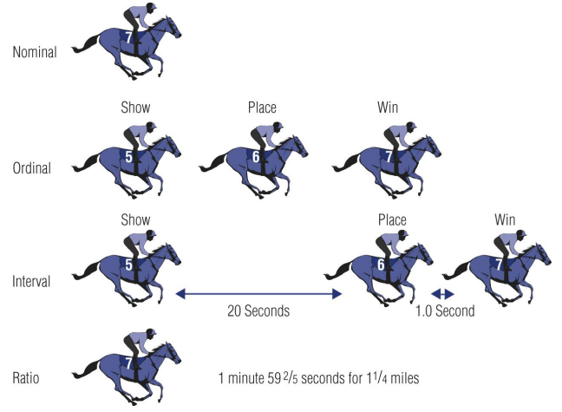
Different Kinds of Data
DATA
Nominal
Ordinal
Interval
Ratio
KODE DOSEN : NKC / MATA KULIAH : PROBABILITAS & STATISTIKA (MUH1F3)

Slide 24
Different Kinds of Data
Scientists make decisions on the basis of data. Data are collection of any number of related observations on one ore more variables. The term data refers to the actual measurements or observations that result from an investigation or survey.
Qualitative Variables measure a quality or characteristic on each experimental unit
Quantitative Variables measure a numerical quantity or amount on each experimental unit.
Data
Qualitative
Quantitative
Discrete
Continuous
KODE DOSEN : NKC / MATA KULIAH : PROBABILITAS & STATISTIKA (MUH1F3)

Slide 25
statistics
STEM and LEAF DIAGRAMS
EXPLORATORY DATA ANALYSIS
BOX and WHISKER PLOTS
STATISTICS
CONFIRMATORY DATA ANALYSIS
KODE DOSEN : NKC / MATA KULIAH : PROBABILITAS & STATISTIKA (MUH1F3)

Slide 26
STEM & LEAF DIAGRAM
A Stem-and-Leaf Diagram is a good way to obtain an informative visual display of a data set $x_{1} , x_{2} , …, x_{n}$ where each number $x_{i}$ consists of at least two digits.
To construct a stem-and-leaf diagram, use the following steps.
Divide each number of $x_{i}$ into two parts: a stem, consisting of one or more of the leading digits, and a leaf, consisting of the remaining digit.
List the stem values in a vertical column.
Record the leaf for each observation beside its stem.
Write the units for stem and leaves on the displays
KODE DOSEN : NKC / MATA KULIAH : PROBABILITAS & STATISTIKA (MUH1F3)

Slide 27
BOX & WHISKER PLOT
The Box-and-Whisker Plot is a graphical display that simultaneously describes several important features of a data set, such as center, spread, departure from symmetry, and identification of unusual observations or outliers. A box plot displays:
Three Quartiles ( $Q_{1}$ , $Q_{2}$ and $Q_{3}$)
Minimum Value ($X_{min})$
Maximum Value ($X_{max})$
Interquartile Range / Hinges Spread / H-Spread → IQR = ($Q_{3}$ - $Q_{1}$)
$One Step ≜1.5 ∙IQR$
$Two Step ≜3.0 ∙IQR$
$Upper Outer Fences(UOF)≜Q_{3}+Two Step$
$Upper Inner Fences(UIF)≜Q_{3}+One Step$
$Lower Outer Fences(LOF)≜Q_{1}−Two Step$
$Lower Inner Fences(LIF)≜Q_{1}−One Step$
A data value X, to be a Mild Outlier if $UIF≤X<UOF$ or $LOF<X≤LIF$
A data value X, to be a Extreme Outlier if $X≥UOF$ or $X≤LOF$
The Five-Number Summary
Outlier Threshold
KODE DOSEN : NKC / MATA KULIAH : PROBABILITAS & STATISTIKA (MUH1F3)

Slide 28
BOX & WHISKER PLOT
$UOF=Q_{3}+Two Step$
$LOF=Q_{1}−Two Step$
$LIF=Q_{1}−One Step$
$UIF=Q_{3}+One Step$
Extreme
Outlier
Extreme
Outlier
Mild Outlier
Mild Outlier
Minimum
Value
$${(X}_{min})$$
Lower Quartile
$${(Q}_{1})$$
Median
$${(Q}_{2})$$
Upper Quartile
$${(Q}_{3})$$
Maximum
Value
$${(X}_{max})$$
Lower Outer
Fences $\text{(}\text{LOF})$
Lower Inner
Fences (LIF)
Upper Inner
Fences (UIF$)$
Upper Outer
Fences $\text{(}\text{UOF})$
Interquartile Range → IQR = $Q_{3}−Q_{1}$
One Step = 1,5 . IQR
One Step = 1,5 . IQR
Two Step = 3 . IQR
Two Step = 3 . IQR
A data value X, to be a Mild Outlier if $UIF≤X<UOF$ or $LOF<X≤LIF$
A data value X, to be a Extreme Outlier if $X≥UOF$ or $X≤LOF$
KODE DOSEN : NKC / MATA KULIAH : PROBABILITAS & STATISTIKA (MUH1F3)

Slide 29
EXAMPLE
The following are 40 Scores on a probability exam. Construct a Stem–and–leaf Diagram & Box-and-Whisker Diagram
61 | 77 | 59 | 33 | 44 | 51 | 11 | 28 | 46 | 53
54 | 40 | 42 | 70 | 42 | 40 | 51 | 46 | 63 | 64
58 | 47 | 42 | 54 | 64 | 54 | 39 | 66 | 46 | 57
25 | 67 | 44 | 17 | 13 | 69 | 13 | 12 | 46 | 48
KODE DOSEN : NKC / MATA KULIAH : PROBABILITAS & STATISTIKA (MUH1F3)

Slide 30
EXAMPLE
The following are 40 Scores on a probability exam. Construct a Stem–and–leaf Diagram & Box-and-Whisker Diagram
61 | 77 | 59 | 33 | 44 | 51 | 11 | 28 | 46 | 53
54 | 40 | 42 | 70 | 42 | 40 | 51 | 46 | 63 | 64
58 | 47 | 42 | 54 | 64 | 54 | 39 | 66 | 46 | 57
25 | 67 | 44 | 17 | 13 | 69 | 13 | 12 | 46 | 48
The percentage of cotton in material used to manufacture men’s shirts follows. Construct a Stem–and–leaf Diagram & Box-and-Whisker Diagram for the data ! Calculate the median and quartiles of these data! Should any points be considered potential outliers?
34.2 | 37.8 | 33.6 | 32.6 | 33.8 | 35.8 | 34.7 | 34.6
33.1 | 36.6 | 34.7 | 33.1 | 34.2 | 37.6 | 33.6 | 33.6
34.5 | 35.4 | 35.0 | 34.6 | 33.4 | 37.3 | 32.5 | 34.1
35.6 | 34.6 | 35.4 | 35.9 | 34.7 | 34.6 | 34.1 | 34.7
36.3 | 33.8 | 36.2 | 34.7 | 34.6 | 35.5 | 35.1 | 35.7
35.1 | 37.1 | 36.8 | 33.6 | 35.2 | 32.8 | 36.8 | 36.8
34.7 | 34.0 | 35.1 | 32.9 | 35.0 | 32.1 | 37.9 | 34.3
33.6 | 34.1 | 35.3 | 33.5 | 34.9 | 34.5 | 36.4 | 32.7
KODE DOSEN : NKC / MATA KULIAH : PROBABILITAS & STATISTIKA (MUH1F3)

Slide 31
EXAMPLE
1. a. Stem & Leaf Diagram
Stem | Leaves |  |  |  |  |  |  |  |  |  |  |  |  | Frequency Cumulative
1 | 1 | 2 | 3 | 3 | 7 |  |  |  |  |  |  |  |  | 5
2 | 5 | 8 |  |  |  |  |  |  |  |  |  |  |  | 7
3 | 3 | 9 |  |  |  |  |  |  |  |  |  |  |  | 9
4 | 0 | 0 | 2 | 2 | 2 | 4 | 4 | 6 | 6 | 6 | 6 | 7 | 8 | 22
5 | 1 | 1 | 3 | 4 | 4 | 4 | 7 | 8 | 9 |  |  |  |  | 31
6 | 1 | 3 | 4 | 4 | 6 | 7 | 9 |  |  |  |  |  |  | 38
7 | 0 | 7 |  |  |  |  |  |  |  |  |  |  |  | 40
KODE DOSEN : NKC / MATA KULIAH : PROBABILITAS & STATISTIKA (MUH1F3)

Slide 32
EXAMPLE
b. Box & Whisker Plot
$Q_{1}=Data ke \frac{1(n+1)}{4}=Data ke \frac{1(40+1)}{4}=Data ke 10\frac{1}{4}=40+\frac{1}{4}∙(40−40)=40$
$Q_{2}=Data ke \frac{2(n+1)}{4}=Data ke \frac{2(40+1)}{4}=Data ke 20\frac{1}{2}=46+\frac{1}{2}∙(47−46)=46.5$
$Q_{3}=Data ke \frac{3(n+1)}{4}=Data ke \frac{3(40+1)}{4}=Data ke 30\frac{3}{4}=58+\frac{3}{4}∙(59−58)=58.75$
$X_{min}=11 , X_{Max}=77$ , $IQR=18.75$ ,$One Step=28.125$and $Two Step=56.25$
$UOF=115$ , $UIF=86.875$, $LOF=−16.25$ and $LIF=11.875$
KODE DOSEN : NKC / MATA KULIAH : PROBABILITAS & STATISTIKA (MUH1F3)

Slide 33
EXAMPLE
Mild Outlier
KODE DOSEN : NKC / MATA KULIAH : PROBABILITAS & STATISTIKA (MUH1F3)

Slide 34
2. a. Stem & Leaf Diagram
Stem | Leaves |  |  |  |  |  |  |  |  |  |  |  |  |  |  |  |  |  |  |  |  | Frequency Cumulative
32 | 1 | 5 | 6 | 7 | 8 | 9 |  |  |  |  |  |  |  |  |  |  |  |  |  |  |  | 6
33 | 1 | 1 | 4 | 5 | 6 | 6 | 6 | 6 | 6 | 8 | 8 |  |  |  |  |  |  |  |  |  |  | 17
34 | 0 | 1 | 1 | 1 | 2 | 2 | 3 | 5 | 5 | 6 | 6 | 6 | 6 | 6 | 7 | 7 | 7 | 7 | 7 | 7 | 9 | 38
35 | 0 | 0 | 1 | 1 | 1 | 2 | 3 | 4 | 4 | 5 | 6 | 7 | 8 | 9 |  |  |  |  |  |  |  | 52
36 | 2 | 3 | 4 | 6 | 8 | 8 | 8 |  |  |  |  |  |  |  |  |  |  |  |  |  |  | 59
37 | 1 | 3 | 6 | 8 | 9 |  |  |  |  |  |  |  |  |  |  |  |  |  |  |  |  | 64
KODE DOSEN : NKC / MATA KULIAH : PROBABILITAS & STATISTIKA (MUH1F3)

Slide 35
b. Box & Whisker Plot
$Q_{1}=33.8$
$Q_{2}=34.7$
$Q_{3}=35.575$
IQR =1.775
$X_{min}=32.1$
$X_{max}=37.9$
One Step = 2.6625
Two Step =5.325
UOF = 40.9
UIF = 38.2375
LOF =28.475
LIF =31.1375
KODE DOSEN : NKC / MATA KULIAH : PROBABILITAS & STATISTIKA (MUH1F3)

Slide 36
KODE DOSEN : NKC / MATA KULIAH : PROBABILITAS & STATISTIKA (MUH1F3)

Slide 37
In their book “Introduction to Linear Regression Analysis” Montgomery, Peck, and Vining presented measurements on NbOCl3 concentration from a tube-flow reactor experiment. The data, in gram-mole per liter × 10⁻³, are as follows. Construct a stem-and-leaf diagram for these data and comment on any important features that you notice !
The times given in the table are the amounts of time (in µ-seconds) of 30 message were received at the receiver. Constructs Stem-Plot and Box-Plot !
The data shown in this table, represent the sample average throughput (in Mbps) of a digital communication channel. Constructs Stem-Plot and Box-Plot
450 | 450 | 473 | 507 | 457 | 452 | 453 | 1215 | 1256
1145 | 1085 | 1066 | 1111 | 1364 | 1254 | 1396 | 1575 | 1617
1733 | 2753 | 3186 | 3227 | 3469 | 1911 | 2588 | 2635 | 2725
1.17 | 1.61 | 1.16 | 1.38 | 3.53 | 0.19 | 0.82 | 2.16 | 1.40 | 3.45
1.23 | 3.76 | 1.94 | 0.96 | 4.75 | 0.92 | 0.75 | 3.07 | 2.91 | 2.21
0.15 | 2.41 | 0.71 | 0.02 | 1.59 | 0.47 | 2.59 | 2.01 | 0.01 | 4.22
KODE DOSEN : NKC / MATA KULIAH : PROBABILITAS & STATISTIKA (MUH1F3)

Slide 38
94.1 | 86.1 | 95.3 | 84.9 | 88.8 | 84.6 | 94.4 | 84.1
93.2 | 90.4 | 94.1 | 78.3 | 86.4 | 83.6 | 96.1 | 83.7
90.6 | 89.1 | 97.8 | 89.6 | 85.1 | 85.4 | 98.0 | 82.9
91.4 | 87.3 | 93.1 | 90.3 | 84.0 | 89.7 | 85.4 | 87.3
88.2 | 84.1 | 86.4 | 93.1 | 93.7 | 87.6 | 86.6 | 86.4
86.1 | 90.1 | 87.6 | 94.6 | 87.7 | 85.1 | 91.7 | 84.5
Recorded the times of a sample of 24 long distance calls placed in a given week, as shown in table. Constructs Stem-Plot and Box-Plot !
13.0 | 5.4 | 17.5 | 14.6 | 6.5 | 9.7
10.3 | 10.5 | 9.2 | 4.1 | 13.3 | 7.7
11.5 | 9.5 | 12.6 | 8.3 | 11.0 | 20.2
16.3 | 13.5 | 9.9 | 16.8 | 19.5 | 12.9
KODE DOSEN : NKC / MATA KULIAH : PROBABILITAS & STATISTIKA (MUH1F3)

Slide 39
The value given in the table are the amounts of time (in µ-seconds) of 80 message were received at the receiver. Is there any outlier?
Frequency Cumulative | Stem | Leaves (unit 0.1)
1 | 7 | 6
2 | 8 | 7
3 | 9 | 7
5 | 10 | 1 | 5
8 | 11 | 0 | 5 | 8
11 | 12 | 0 | 1 | 3
17 | 13 | 1 | 3 | 3 | 4 | 5 | 5
25 | 14 | 1 | 2 | 3 | 5 | 6 | 8 | 9 | 9
37 | 15 | 0 | 0 | 1 | 3 | 4 | 4 | 6 | 7 | 8 | 8 | 8 | 8
47 | 16 | 0 | 0 | 0 | 3 | 3 | 5 | 7 | 7 | 8 | 9
57 | 17 | 0 | 1 | 1 | 2 | 4 | 4 | 5 | 6 | 6 | 8
64 | 18 | 0 | 0 | 1 | 1 | 3 | 4 | 6
70 | 19 | 0 | 3 | 4 | 6 | 9 | 9
74 | 20 | 0 | 1 | 7 | 8
75 | 21 | 8
78 | 22 | 1 | 8 | 9
79 | 23 | 7
80 | 24 | 5
KODE DOSEN : NKC / MATA KULIAH : PROBABILITAS & STATISTIKA (MUH1F3)

Slide 40
References
“Applied Statistics and Probability for Engineering 6th Edition’’ by Douglas C. Montgomery and George C. Runger.
“Introduction to Probability and Statistics 4th Edition” by William Mendenhall, Robert J. Beaver and Barbara M. Beaver
“Exploratory Data Analysis in Business and Economics” by Thomas Cleff
KODE DOSEN : NKC / MATA KULIAH : PROBABILITAS & STATISTIKA (MUH1F3)

Slide 41
TERIMAKASIH
-SELAMAT BELAJAR-
KODE DOSEN : NKC / MATA KULIAH : PROBABILITAS & STATISTIKA (MUH1F3)

